Slide 1
RyniXsoft Hybrid Internship Week -3
BY
SWETHASUPRIYA AS

Slide 2
Week 3
Sprint 3 – High-Fidelity UI Design
• Design complete UI in Figma / Adobe XD
• Apply typography system
• Define color system & spacing guidelines
• Create responsive layouts (Desktop + Mobile)
• Submit design updates

Slide 3
Objective & Screens
Objective:
Create high-fidelity UI screens
Apply design system (colors, typography, spacing)
Ensure responsive design
Screens Designed:
Login Page
Dashboard (Desktop & Mobile)
Task Page
Admin Panel
Apply Leave & HR Approval UI

Slide 4
Design System
Color System
Blue → Primary actions
Green → Approve
Red → Reject
Typography
Clear and readable fonts
Proper heading & content hierarchy
Spacing
Consistent margins and alignment
Clean layout structure

Slide 5
Challenges & Conclusion
Challenges:
Maintaining consistency
Designing responsive layouts
Conclusion:
Completed full UI design system
Improved usability and user experience
Ready for final submission

Slide 6
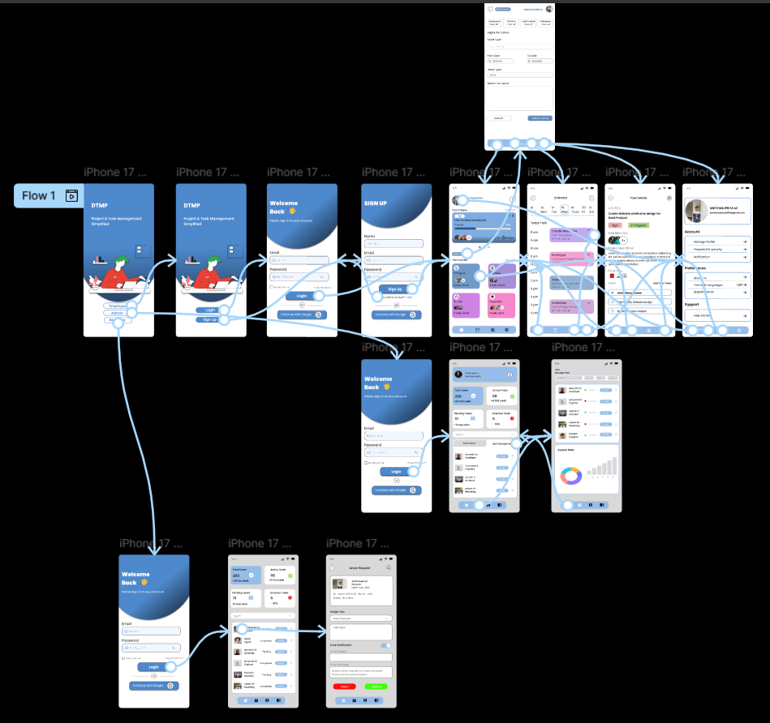
Mobile UI

Slide 7
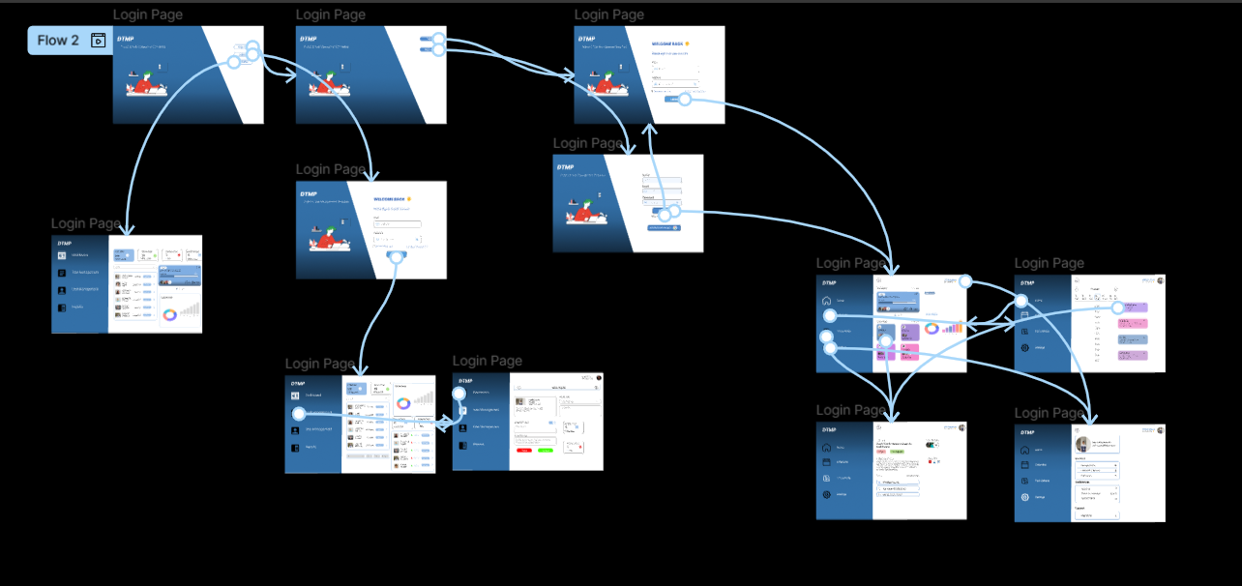
Desktop UI

Slide 8
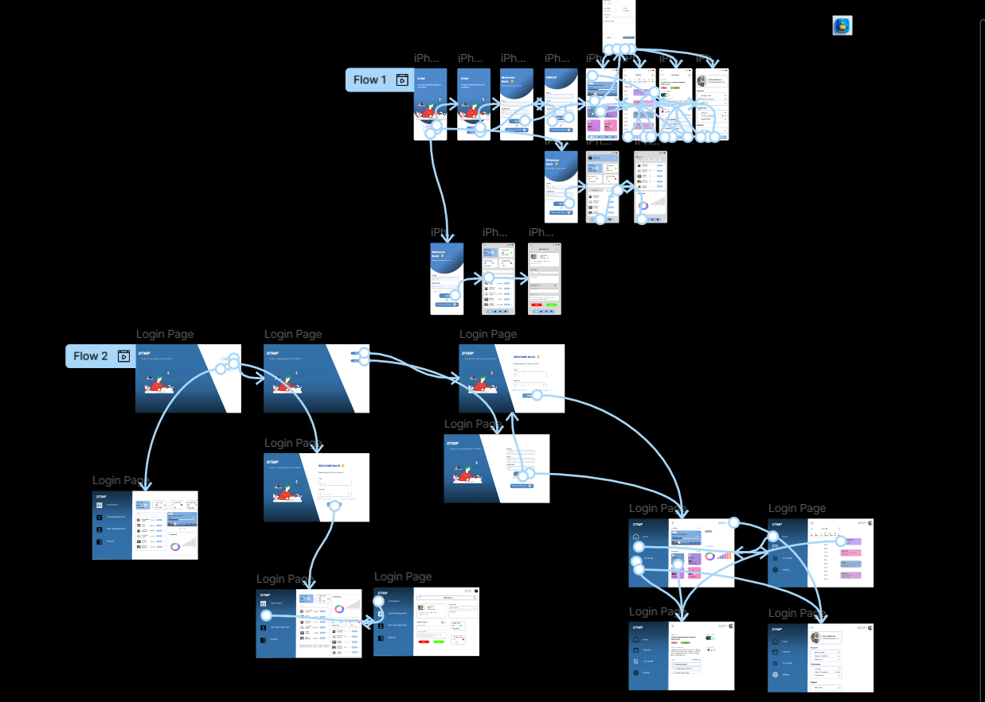
Overall Design

Slide 9


